Slide 1
Using the fx-83/85GT CW for statistics
Calculator functionality

Slide 2
How our teaching resources are designed for the classroom

Slide 3
I can use the fx-83/85GT CW to perform calculations with data.

Slide 4
The frequency is the number of times an event occurs; or the number of individuals (people, animals etc.) with some specific property.
The (arithmetic) mean for a set of numerical data is the sum of the values divided by the number of values. It is a measure of central tendency representing the average of the values.
The median is the central (middle) piece of data when the data are in numerical order. It is a measure of central tendency representing the average of the values.

Slide 5
The mode is the most frequent value. It is a measure of central tendency representing the average of the values.
A statistical summary sums up the features of a data set. It may contain the mean, median and/or mode which measure the central tendency. It may also contain the range which measures the spread.

Slide 6

Using the fx-83/85GT CW for statistics
Finding the mean from a frequency table
Analysis

Slide 7
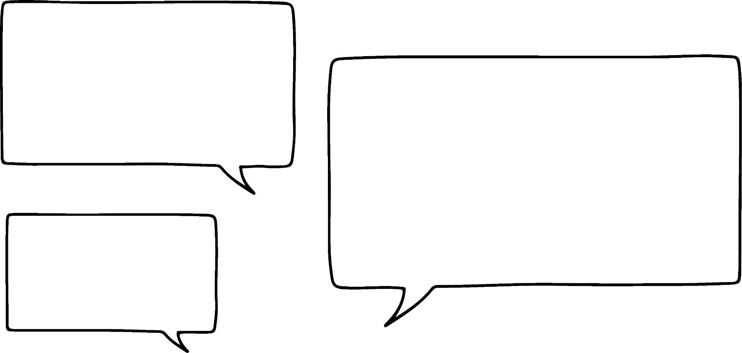
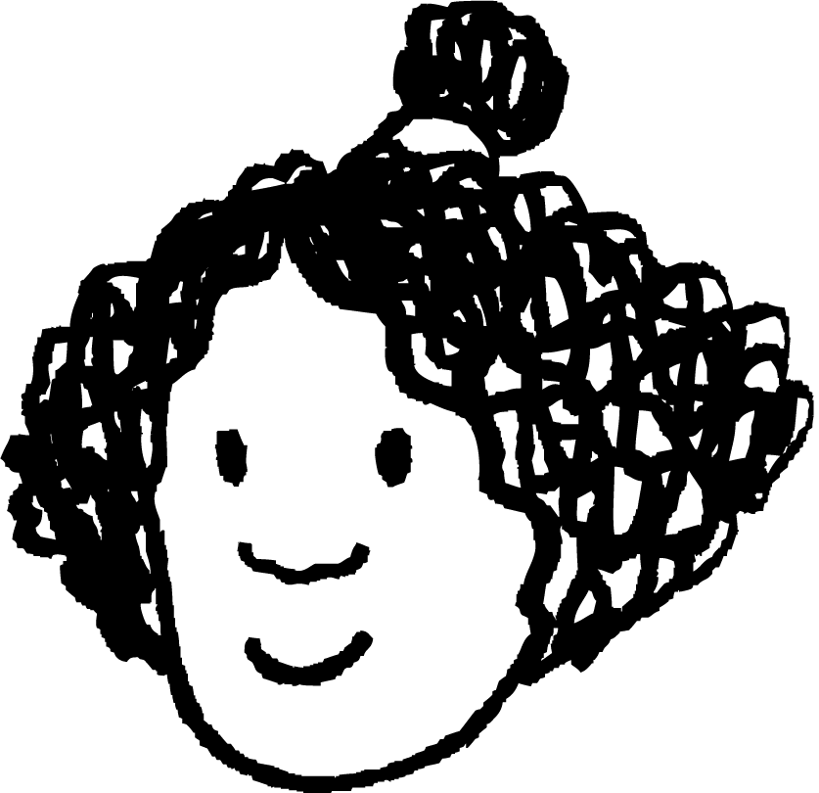

Finding the mean from a frequency table
The (arithmetic) mean for a set of numerical data is the sum of the values divided by the number of values.
Does this mean I need to use the calculate mode to add all the numbers before dividing?
There is an easier way to calculate the mean.
Izzy
Jun

Slide 8
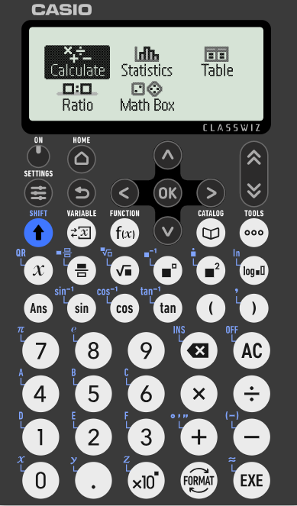
Finding the mean from a frequency table
In this lesson, we will be using the Casio fx-83/85GT CW model.
We will cover how to use this calculator to carry out different calculations.
After switching the calculator on, you will see this screen.

Slide 9
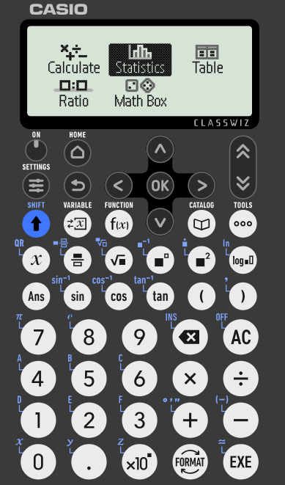
Finding the mean from a frequency table
You can use the arrow keys to navigate between the options. We are going to begin by focusing on how to calculate the mean from a frequency table.
Navigate to ‘Statistics’ and press the ‘EXE’ button.

Slide 10
Finding the mean from a frequency table
Group size | Frequency
0 | 1
1 | 1
2 | 2
3 | 2
4 | 3
5 | 2
Here is a table showing the number of diners at various tables in a restaurant.
This represents 3 tables, each with 4 diners.
This represents 2 tables, each with 5 diners.

Slide 11
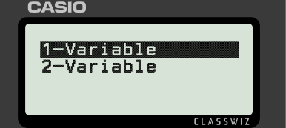
Finding the mean from a frequency table
Group size | Frequency
0 | 1
1 | 1
2 | 2
3 | 2
4 | 3
5 | 2
We are dealing with one set of data so we choose ‘1-Variable’ from the Statistics menu.

Slide 12
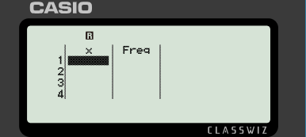
Finding the mean from a frequency table
Group size | Frequency
0 | 1
1 | 1
2 | 2
3 | 2
4 | 3
5 | 2
We now need to put the values from the table into the calculator.
If the Freq column is missing, press ‘Tools’, select ‘Frequency’ then select ‘On’.

Slide 13
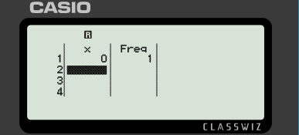
Finding the mean from a frequency table
Group size | Frequency
0 | 1
1 | 1
2 | 2
3 | 2
4 | 3
5 | 2
Enter 0 and then press ‘EXE’. What value appears in the ‘Freq’ column?

Slide 14
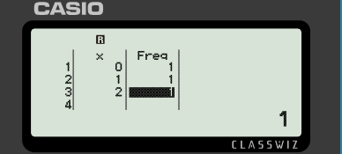
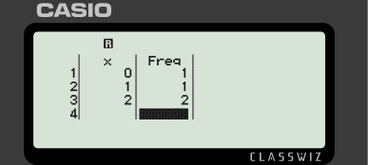
Finding the mean from a frequency table
Group size | Frequency
0 | 1
1 | 1
2 | 2
3 | 2
4 | 3
5 | 2
1 is the default frequency value.
You can change the value by navigating to the value you wish to change, typing the correct value and pressing ‘EXE’.

Slide 15
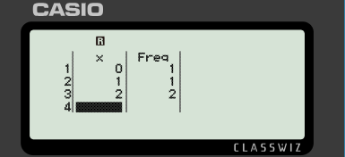

Finding the mean from a frequency table
Group size | Frequency
0 | 1
1 | 1
2 | 2
3 | 2
4 | 3
5 | 2
Enter the remaining values into the calculator.

Slide 16
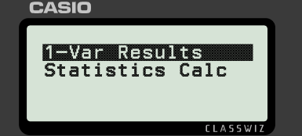
Finding the mean from a frequency table
Group size | Frequency
0 | 1
1 | 1
2 | 2
3 | 2
4 | 3
5 | 2
Once all the values have been correctly entered, press ‘EXE’.
Press ‘EXE’ again to generate the mean for the data you entered.

Slide 17
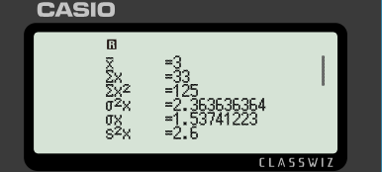
Finding the mean from a frequency table
Group size | Frequency
0 | 1
1 | 1
2 | 2
3 | 2
4 | 3
5 | 2
Once all the values have been correctly entered, press ‘EXE’.
The mean is written as

Slide 18
Finding the mean from a frequency table
Group size | Frequency
0 | 1
1 | 1
2 | 2
3 | 2
4 | 3
5 | 2
Once all the values have been correctly entered, press ‘EXE’.
The mean is written as
What is the value of the mean?
3

Slide 19
Finding the mean from a frequency table
The (arithmetic) mean for a set of numerical data is the sum of the values divided by the number of values.
But what if I have a frequency bar chart and not a table?
Read the values off the bar chart to create the table.
Izzy
Jun

Slide 20
Finding the mean from a frequency table
To quickly clear all existing data in the table, press ‘Tools’ then select ‘Edit’ then ‘Delete All’.
You now have a blank table to put the new values into.
Alternatively, you can just overwrite the existing values.

Slide 21
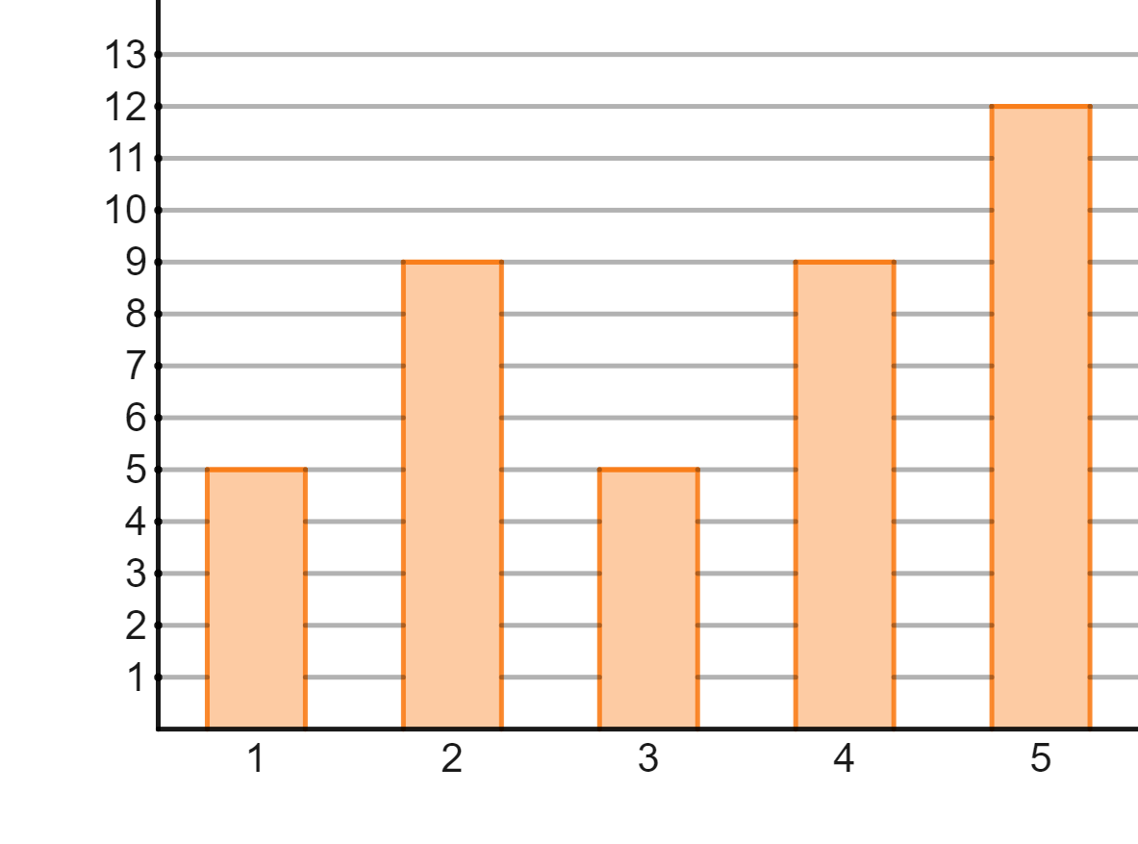
Finding the mean from a frequency table
This bar chart shows reviews of a restaurant.
Frequency
Star rating

Slide 22
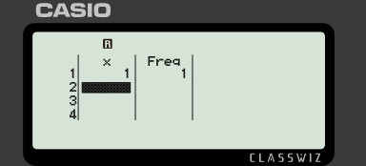
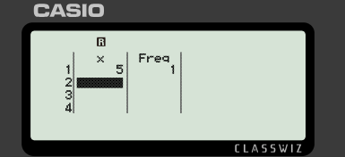
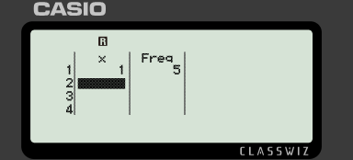

Finding the mean from a frequency table
What will the correct first row of the table look like?
Frequency
Star rating

Slide 23
Finding the mean from a frequency table
Calculate the mean rating for this restaurant.
Frequency
The mean rating is 3.35
Star rating

Slide 24
Finding the mean from a frequency table
1) This frequency table shows the number of goals scored in each match by all the teams in a club over one football season.
Goals scored | Frequency
0 | 19
1 | 34
2 | 21
3 | 15
4 | 11
What was the mean number of goals scored?

Slide 25
Finding the mean from a frequency table
2) This frequency table shows the star rating received by a restaurant over its opening weekend.
Star rating | Frequency
1 | 12
2 | 18
3 | 21
4 | 38
5 | 45
What was the mean star rating?

Slide 26
Finding the mean from a frequency table
3) A class take a quiz, marked out of 6. The frequency table shows the results for the class.
Quiz score | 0 | 1 | 2 | 3 | 4 | 5 | 6
Frequency | 3 | 4 | 4 | 7 | 10 | 4 | 1
What is the mean number of marks per pupil?

Slide 27
Finding the mean from a frequency table
4) The frequency table shows the number of bedrooms in different houses within an area of a town.
Bedrooms | Frequency
1 | 20
2 | 93
3 | 54
4 | 33
What is the mean number of bedrooms?

Slide 28
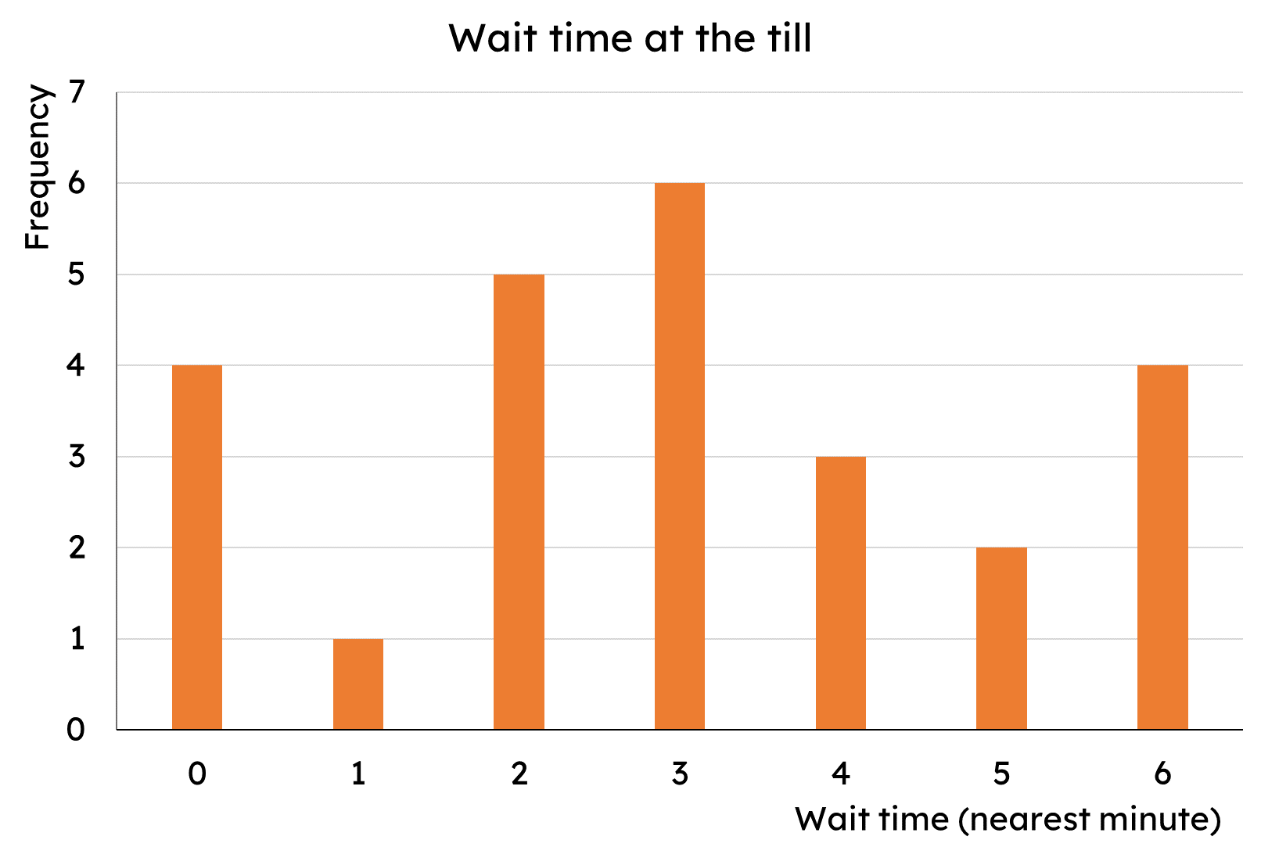
Finding the mean from a frequency table
5) The bar chart shows the length of time customers spent waiting at a self-service till (to the nearest minute).
What is the mean wait time?

Slide 29
Finding the mean from a frequency table
1) This frequency table shows the number of goals scored in each match by all the teams in a club over one football season.
Goals scored | Frequency
0 | 19
1 | 34
2 | 21
3 | 15
4 | 11
What was the mean number of goals scored?
1.65 goals (which rounds to 2)

Slide 30
Finding the mean from a frequency table
2) This frequency table shows the star rating received by a restaurant over its opening weekend.
Star rating | Frequency
1 | 12
2 | 18
3 | 21
4 | 38
5 | 45
What was the mean star rating?
3.64… stars (which rounds to 4)

Slide 31
Finding the mean from a frequency table
3) A class take a quiz, marked out of 6. The frequency table shows the results for the class.
Quiz score | 0 | 1 | 2 | 3 | 4 | 5 | 6
Frequency | 3 | 4 | 4 | 7 | 10 | 4 | 1
What is the mean number of marks per pupil?
3 marks

Slide 32
Finding the mean from a frequency table
4) The frequency table shows the number of bedrooms in different houses within an area of a town.
Bedrooms | Frequency
1 | 20
2 | 93
3 | 54
4 | 33
What is the mean number of bedrooms?
2.5 bedrooms (which rounds to 3)

Slide 33
Finding the mean from a frequency table
5) The bar chart shows the length of time customers spent waiting at a self-service till (to the nearest minute).
What is the mean wait time?
3 minutes

Slide 34
Using the fx-83/85GT CW for statistics
Finding the mean from a frequency table
Analysis

Slide 35
Analysis
Your calculator can do more than just calculate the mean.
When I found the mean, there was lots more shown on the screen.
Other calculations are performed at the same time.
Izzy
Jun

Slide 36
Analysis
Group size | Frequency
0 | 1
1 | 1
2 | 2
3 | 2
4 | 3
5 | 2
Here is a table showing the number of diners at various tables in a restaurant.
When we calculated the mean, this information was displayed:

Slide 37
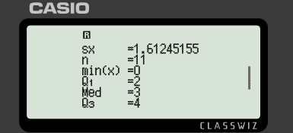
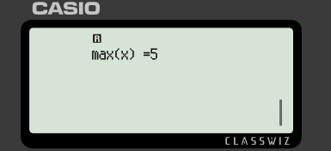
Analysis
Pressing the down arrow key reveals more information.

Slide 38
Analysis
We are going to consider the information needed for GCSE maths.
Mean
The sum of the values
(may be written as ∑fx )

Slide 39
Analysis
We are going to consider the information needed for GCSE maths.
The number of values
Minimum x value
Lower quartile
Median
Upper quartile

Slide 40
Analysis
We are going to consider the information needed for GCSE maths.
Maximum x value

Slide 41
Analysis
For this data, calculate the following:
Group size | Frequency
0 | 1
1 | 1
2 | 2
3 | 2
4 | 3
5 | 2
a) Mean
b) Median
c) Interquartile range

Slide 42
Analysis
For this data, calculate the following:
Group size | Frequency
0 | 1
1 | 1
2 | 2
3 | 2
4 | 3
5 | 2
a) Mean = 3
b) Median = 3
c) Interquartile range = 4 − 2 = 2

Slide 43
Analysis
1) This frequency table shows the number of goals scored in each match by all the teams in a club over one football season.
Goals scored | Frequency
0 | 19
1 | 34
2 | 21
3 | 15
4 | 11
a) Calculate the median.
b) Calculate the interquartile range.
c) Would the club prefer to report the mean or median as the average number of goals scored? Why?

Slide 44
Analysis
2) This frequency table shows the star rating received by a restaurant over its opening weekend.
Star rating | Frequency
1 | 12
2 | 18
3 | 21
4 | 38
5 | 45
a) Calculate the median.
b) Calculate the interquartile range.
c) Would the restaurant prefer to report the mean or median as the average rating? Why?

Slide 45
Analysis
3) The frequency table shows the number of bedrooms in different houses within an area of a town.
Bedrooms | Frequency
1 | 20
2 | 93
3 | 54
4 | 33
A developer wishes to build more expensive houses (3+ bedrooms) but the local council want cheaper housing. The council argue that there are already enough houses with 3 or more bedrooms.
Are the council correct? Use the data to support your decision.

Slide 46
Analysis
4) The bar chart shows the length of time customers spent waiting at a self-service till (to the nearest minute).
Management want every customer to be queuing for less than the average queue time.
a) Calculate the average queue time.
b) Explain why it is not possible for everyone to queue for less time than the average queue time.

Slide 47
Analysis
1) This frequency table shows the number of goals scored in each match by all the teams in a club over one football season.
Goals scored | Frequency
0 | 19
1 | 34
2 | 21
3 | 15
4 | 11
a) Calculate the median.
1 goal
b) Calculate the interquartile range.
3 − 1 = 2 goals

Slide 48
Analysis
1) This frequency table shows the number of goals scored in each match by all the teams in a club over one football season.
Goals scored | Frequency
0 | 19
1 | 34
2 | 21
3 | 15
4 | 11
c) Would the club prefer to report the mean or median as the average number of goals scored? Why?
Mean = 1.65 goals. Median = 1 goal.
The club would prefer to report the mean as it rounds to 2 goals making the club’s performance look better.

Slide 49
Analysis
2) This frequency table shows the star rating received by a restaurant over its opening weekend.
Star rating | Frequency
1 | 12
2 | 18
3 | 21
4 | 38
5 | 45
a) Calculate the median.
4 stars
b) Calculate the interquartile range.
5 − 3 = 2 stars

Slide 50
Analysis
2) This frequency table shows the star rating received by a restaurant over its opening weekend.
Star rating | Frequency
1 | 12
2 | 18
3 | 21
4 | 38
5 | 45
c) Would the restaurant prefer to report the mean or median as the average rating? Why?
Mean = 3.64… stars. Median = 4 stars.
The restaurant could report either but the median does not need to be rounded.

Slide 51
Analysis
3) The frequency table shows the number of bedrooms in different houses within an area of a town.
Bedrooms | Frequency
1 | 20
2 | 93
3 | 54
4 | 33
A developer wishes to build more expensive houses (3+ bedrooms) but the local council want cheaper housing. The council argue that there are already enough houses with 3 or more bedrooms.
Are the council correct? Use the data to support your decision.

Slide 52
Analysis
3) The frequency table shows the number of bedrooms in different houses within an area of a town.
Bedrooms | Frequency
1 | 20
2 | 93
3 | 54
4 | 33
Mean = 2.5 bedrooms. Median = 2 bedrooms.
Interquartile range = 3 − 2 = 1
E.g.
If the council uses the mean, then they can round and state that the average number of bedrooms in houses in this area is 3. Therefore there are plenty of houses with 3 (or more) bedrooms in.

Slide 53
Analysis
4) The bar chart shows the length of time customers spent waiting at a self-service till (to the nearest minute).
Management want every customer to be queuing for less than the average queue time.
a) Calculate the average queue time.
Mean = Median = Mode = 3 minutes

Slide 54
Analysis
4) The bar chart shows the length of time customers spent waiting at a self-service till (to the nearest minute).
b) Explain why it is not possible for everyone to queue for less time than the average queue time.
Averages are a measure of central tendency. It is possible for everyone to queue for the average time but not for everyone to be below. If everyone’s time decreased, so would the average.

Slide 55
Using the fx-83/85GT CW for statistics
Some calculators can perform more than just basic calculations.
The fx-83/85GT CW can produce a statistical summary of a set of data.
The summary includes the mean, median, upper and lower quartiles.

Slide 56

© Oak National Academy 2025.
Produced in partnership with Casio and Mathematics in Education and Industry.
Licensed on the Open Government Licence v3.0, except where otherwise stated. See Oak terms and conditions.

